Slide 1
Getting a Data Science Job as a Beginner
4/16/2022

Slide 2
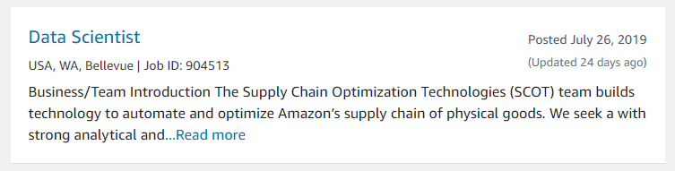
What is Data Science?
Broad definition, essentially science of using data and involves many different roles and skills
Focus on actual job postings and salary/company reviews
You may find your desired role under machine learning engineer, data analyst, data engineer, or data scientist

Slide 3
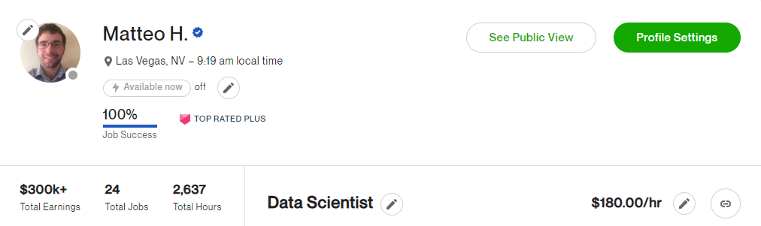
Why Listen to Me?
I’ve worked in data science and have had success in finding clients and jobs
Sharing my perspective but implore you to seek out other data scientists’ opinions

Slide 4
Learning Roadmap
What excited you about data science?
Focus on what roles excite you by scouring job postings
Look up backgrounds of those with jobs you want
Think from the mindset of the company hiring you. What do they want? Can you become that?
Build projects that are directly relevant to that tech stack and problem set
It’s OK if your conclusion is the interesting thing you thought would be there isn’t. Knowing there is nothing is still something
Show you can communicate your results. Blogs like David Robinson’s are great Understanding the beta distribution (using baseball statistics) – Variance Explained
He is a bit more deep into math than you may end up being
Study the gaps in your knowledge but be focused. I would stress end to end ability to solve a problem for a beginner
Try out Kaggle to improve your modeling by participating in a live competition
It may be humbling or empowering, either way very useful
… Congratulations – you are now very hirable!

Slide 5
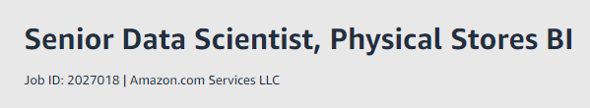
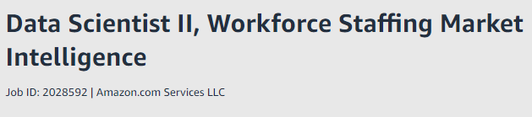
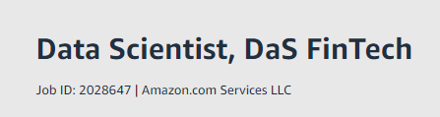
Amazon Job Board
Does not require a masters degree
Likely will be doing many small projects where 80/20 solutions work
Running experiments
No degree required
Some travel
Likely cares most about communication and ability to work with different dataset
This role is more vague and requires a Masters Degree Data Scientist, DaS FinTech - Job ID: 2028647 | Amazon.jobs
Work with data engineers

Slide 6
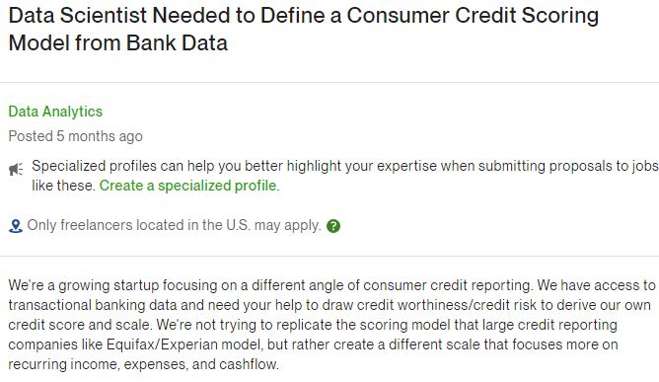
Upwork
Upwork is great for learning about industries and getting work
Find job postings, save the post, come back months later and see who was hired if anyone and if you want to improve your background to fit that job

Slide 7
Focus on Job Types
Data science is broad you should focus on a niche
Types of Problems or Approaches
Time Series Forecasting
Classification Problems
Neural Networks
Fraud Detection
Computer Vision (object detection, video, OCR)
Natural Language Processing (NLP)
Speech
Some of the Many Industries
Trading
Finance
Operations Research
E-Commerce
SaaS

Slide 8
Be Able to Handle a Complete Project
Problem/Opportunity Realized
Formal Machine Learning Objective
Codify the problem
Choose scoring function for model (and be able to justify why)
Develop Solution
Ensure Model Works
Quality control
Holdout set test
Allow Programmatic Access
API development
Daily Batch Output
Communication
Present final results
Work effort estimates
Defend and collaborate with your approach

Slide 9
What Data Science Managers Say
Kaggle has great resources on YouTube for this
How to Build a Compelling Data Science Portfolio & Resume | Kaggle - YouTube
https://youtu.be/xrhPjE7wHas?t=1745 Focus on interesting projects!
Am I a Good Fit? Identifying Your Best Data Science Job Opportunities | Kaggle – YouTube Good overview of job roles
Be sure to read the video comments
This video is a quick good overview Get NOTICED in Data Science!!! (3 types of GREAT projects) - YouTube

Slide 10
Create New Projects
Kaggle can be good for more structured problems where the last few percent of optimization is worth many more $$ to a company
Many companies are well served by 80/20 approaches to data science
Check out my tutorials on Github for help getting started with installation and basic commands.
rogerfitz/tutorials

Slide 11
Chicitycrime: A Portfolio Piece I did
I got a lot of questions about rogerfitz/chicitycrime: An investigation of crime in chicago (github.com)
Took a few weekends to build but was well worth it
Focus on interesting problems to you
Demonstrate self sufficiency and ability to handle direction without too much supervision
Good hiring managers don’t expect you to know everything they want but to be moldable
Finding data and defining the problem is one of the most important steps, Kaggle skips that for you
“Battery, which includes shootings, is among the crimes that increase most as temperature rises, as do theft and criminal damage. However, homicide does not show a relationship to temperature, nor do drug crimes.” - Does a hot summer mean more crime? Here's what the data show - Chicago Tribune

Slide 12
Good luck!
Data science can be hard to break into
It’s not the only career path
Read about the role more on Data Science (reddit.com) and search for blog posts about the role
Coming up with analysis to support a decision is important but sometimes overkill for the people actually making the decisions
Maintain focus while keeping big picture in mind

